Slide 1
Apache Oozie

Slide 2
Apache Oozie
Apache Oozie is a workflow scheduling system designed to orchestrate and manage Hadoop jobs (MapReduce, Hive, Spark, etc.).
It supports time-based scheduling (e.g., run every day at 12 AM) and event-based triggers (e.g., start a job when a file appears in HDFS).
Oozie chains multiple jobs together, ensuring that tasks execute in a specific order (DAG-based workflow).
Works seamlessly with Hive, Pig, MapReduce, Spark, and HDFS, making it ideal for big data pipelines.
If a job fails, Oozie can retry, resume, or rerun workflows without starting everything from scratch.

Slide 3
What is Apache Oozie
Oozie workflow jobs are represented using Directed Acyclic Graphs.
Oozie Supports three types of Jobs:
Workflow engine: Responsibility of a workflow engine is to store and run workflows composed of Hadoop jobs e.g., MapReduce, Pig, Hive.
Coordinator engine: It runs workflow jobs based on predefined schedules and availability of data.
Bundle: Higher level abstraction that will batch a set of
coordinator jobs

Slide 4
Types of nodes in Oozie Workflow
Control Flow nodes: define the beginning and the end of the workflow. They
include start, end and optional fail nodes.
Action Nodes: are where the actual processing tasks are defined. When an
action node finishes, the remote systems notify Oozie and the next node in the workflow is executed. Action nodes can also include HDFS commands.
Fork/Join nodes: enable parallel execution of tasks in the workflow. The fork node enables two or more tasks to run at the same time. A join node represents a rendezvous point that must wait until all forked tasks complete.
Control flow nodes: enable decisions to be made about the previous task. Control decisions are based on the results of the previous actions. Decision nodes are essentially switch-case statement that use JSP EL (Java Server Pages
– Expression Language) that evaluate to either true or false.

Slide 5
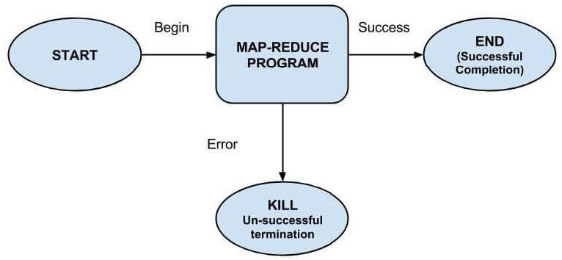
Example Workflow Diagram

Slide 6
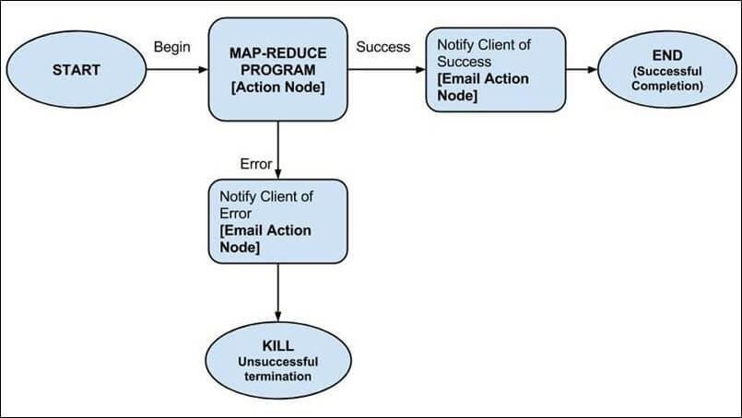
More Complex Example Workflow Diagram

Slide 7
Apache Mahout
Apache Mahout is a scalable machine learning framework designed for clustering, classification, and collaborative filtering on big datasets.
Mahout provides scalable implementations of ML algorithms like K-Means, Naïve Bayes, Random Forest, and Singular Value Decomposition (SVD).
Uses mathematical abstractions (such as the Mahout-Samsara engine) to handle large datasets efficiently.
Works well with HDFS, HBase, and Apache Hive, making it useful for big data analytics applications.

